Slide 1

EMB-101: Emergence of Bangladesh Lecture-5
British India: 1912-1947

Slide 2
Swadeshi Movement
Annul partition
Establish self rule
Boycott British goods
Engage in civil disobedience
Commit political assassinations

Slide 3
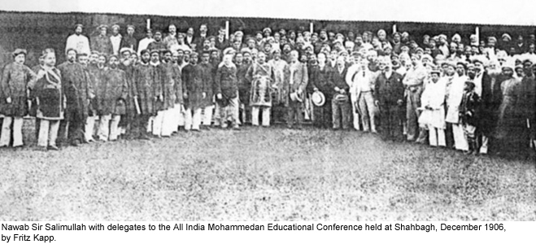
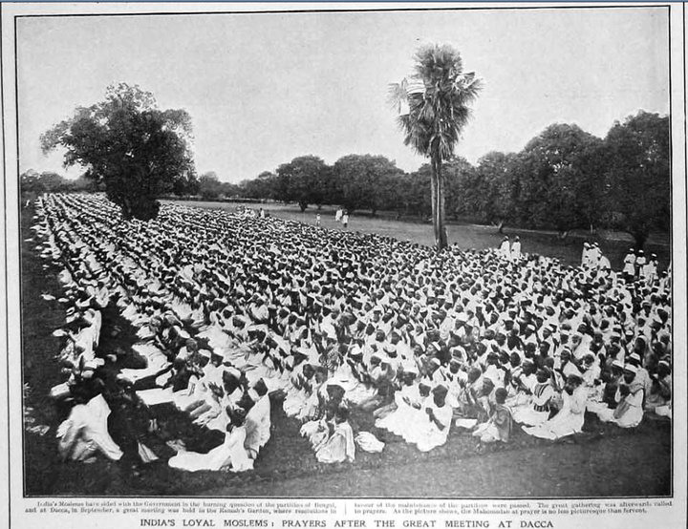
Muslim Response
Prayer gathering after a meeting at Dacca in 1906
This AIME conference laid down the foundation of Muslim League
All India Muslim League was formed on 30 December 1906

Slide 4
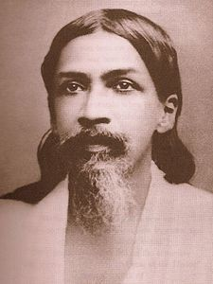
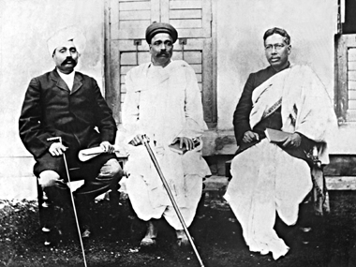
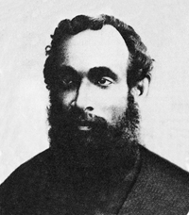
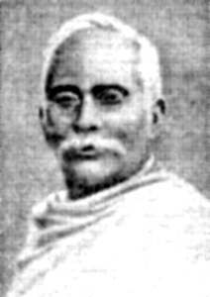
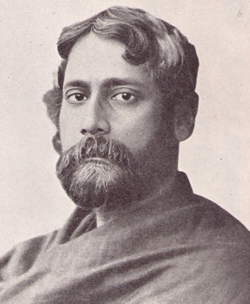
Swadeshi Movement
Lala Lajpat Rai,
Bal Gangadhar Tilak
&
Bipin Chandra Pal –
The three leaders who played vital role in Swadeshi Movement
Sri Aurobindo Ghosh
Surendranath Banerjee
Aswini Kumar Dutta
Rabindranath Tagore in 1905

Slide 5
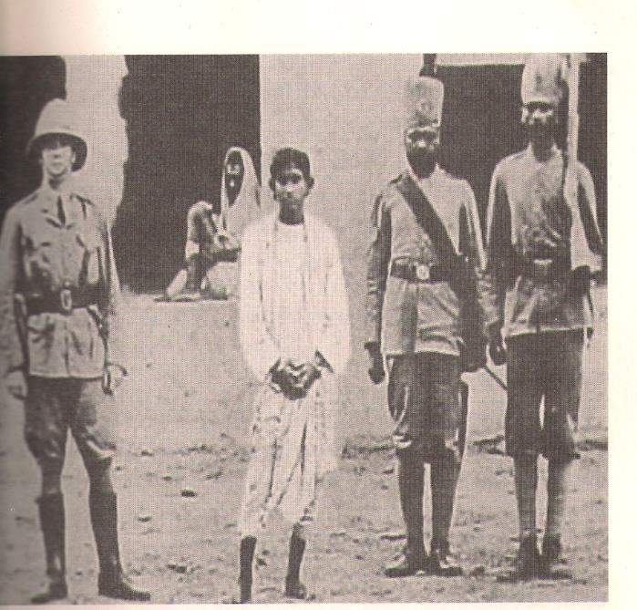
‘Jugantar’ (‘New Era’)
April 30, 1908: Two New Era revolutionaries, Khudiram Bose and Prafulla Chaki throw a bomb at a carriage they believed was carrying a notorious Raj official
The bombing stuns the Raj and ignites the armed revolutionary struggle within the subcontinent that will continue in one form or the other until 1938 and during 1942-1943
The martyrdom of Khudiram and Prafulla reinvigorates the militant anti-colonial movement

Slide 6
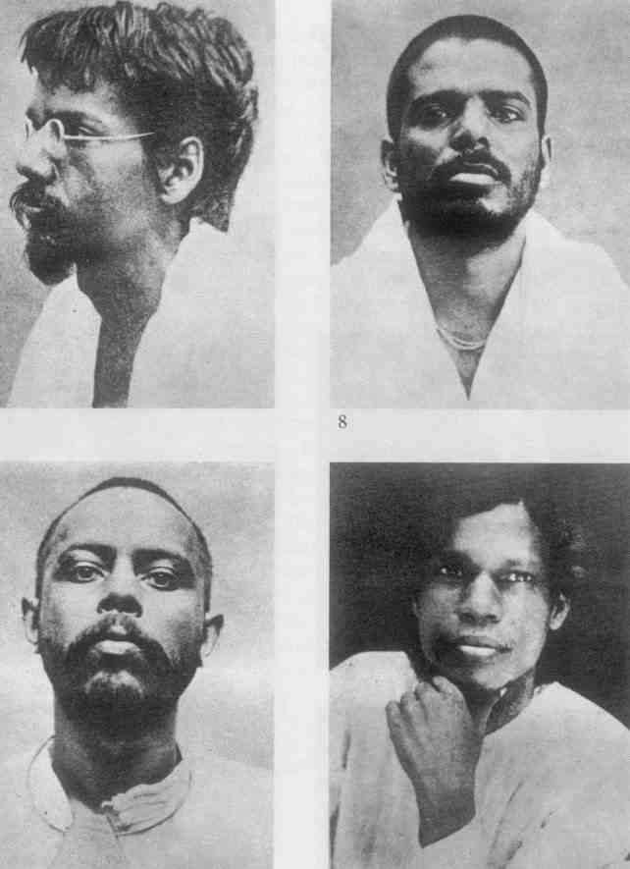
Barindra Kumar Ghose, Upendranath Banerjee, Ullaskar Dutt & Hem Chandra Das

Slide 7
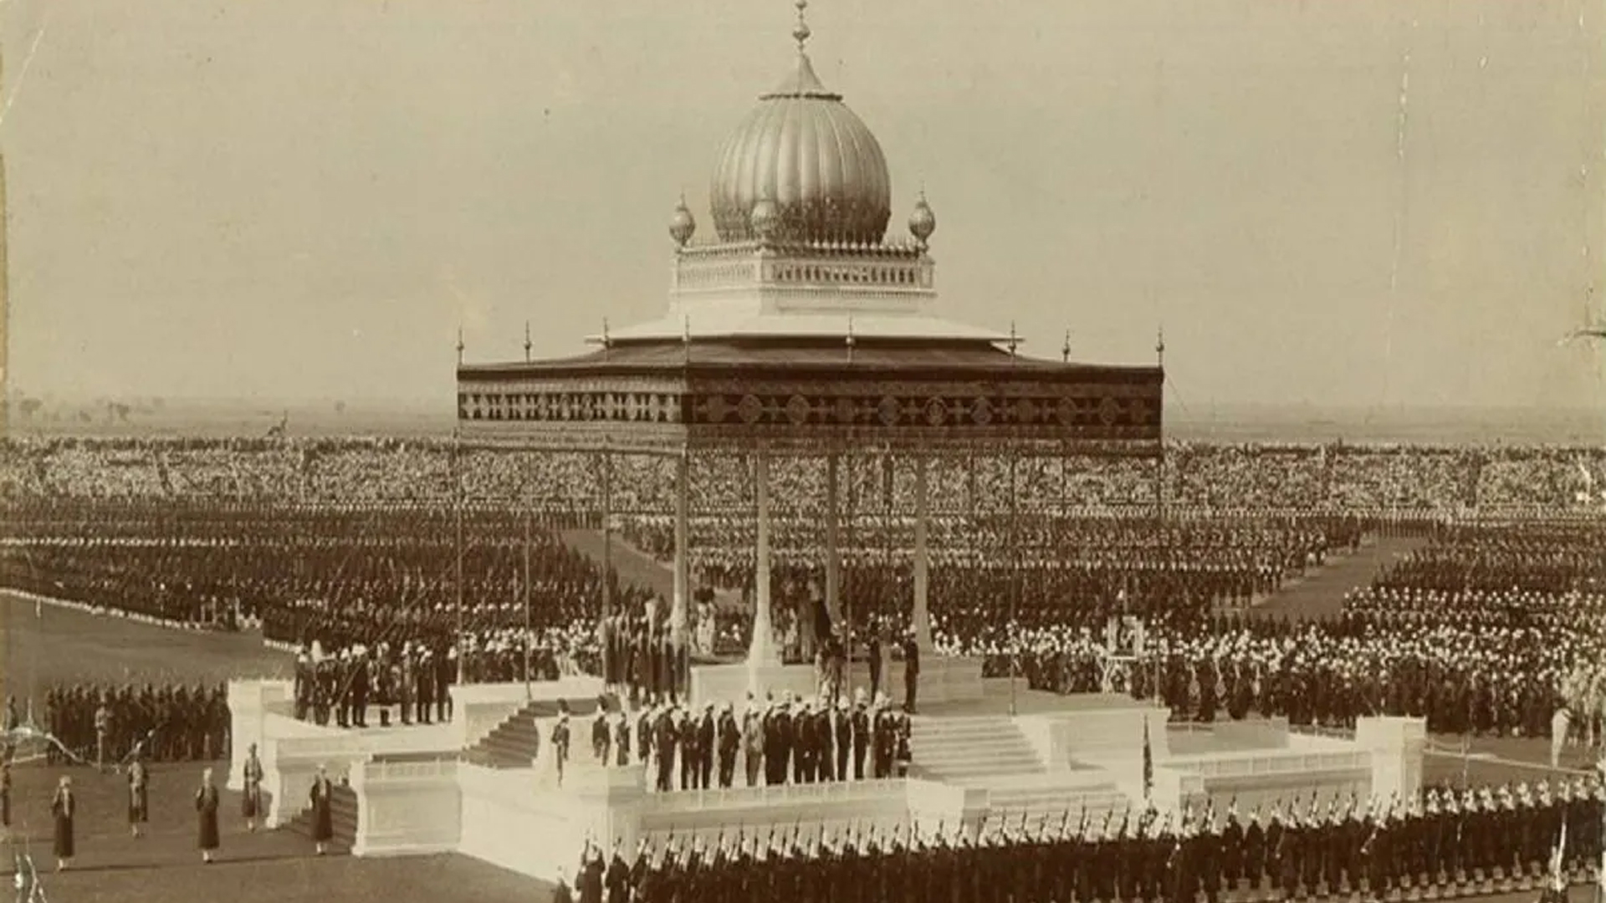
PARTITION ANNULMENT & SEPARATE ELECTORATES
Partition of Bengal reversed (1911)
Capital of the Raj is moved to Delhi
Bengal loses its preeminence in the subcontinent; as Curzon had originally hoped
Bengali muslims are unhappy at the loss their majority province; political mobilization remains; communal issues remain unresolved
1909: separate electorates are created for Hindus, Muslims and other religious/categorized communities

Slide 8
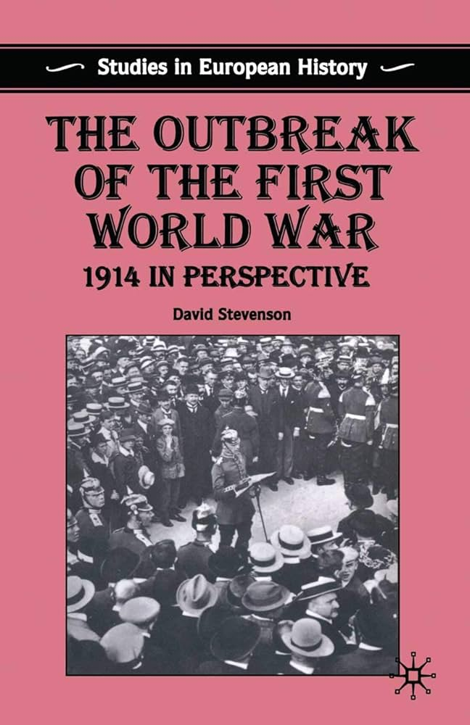
OUTBREAK OF WORLD WAR I
August 1914: outbreak of the first world war
Congress and the league pledge loyalty and collaboration in return for vague promises of ‘self-rule’
Over a £ 1 billion pounds sterling additionally extracted from the subcontinent as a ‘gift’
Food and grain forcibly seized from farmers to feed British, mercenary and other empire-allied forces
Famine-like conditions return to the subcontinent

Slide 9
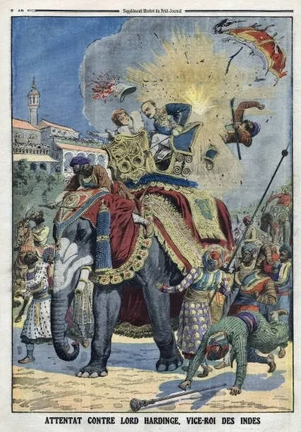
REVOLUTIONARY BOMBING
1912: Bengal revolutionaries bomb Viceroy during his inaugural entry to Delhi
Bengal new era groups, Sikh ‘Ghadar’ (‘rebellion’ or ‘mutiny’) and Pan-Islamist revolutionaries join hands with the German and Ottoman Empires in a bid overthrow the Raj
A provisional government is formed in Kabul
February 21, 1915: planned 1857-style uprising with German assistance fails
Rash Behari Bose, principal mastermind of 1912 and 1915 escapes to Imperial Japan

Slide 10
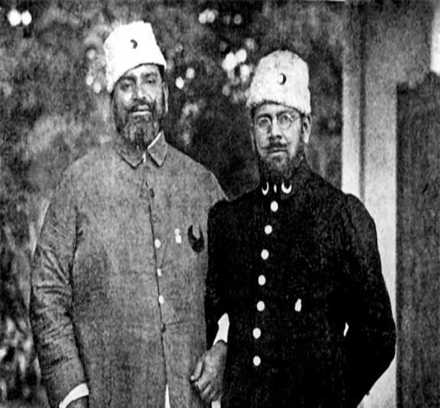
Khilafat
Dismemberment of Ottoman Empire by British angered Muslims; Khilafat movement
Mohammad and Shaukat Ali
Gandhi supported Khilafat cause to enlist Muslim support

Slide 11
Khilafat and Non-cooperation Movement
Rowlatt Act and Jalianwallah Bagh massacre sparked Satyagraha
Gandhi linked issues of of Swaraj (Self-Government) with the Khilafat demands at Nagpur Congress Session (1920)
Non-cooperation plan adopted at the session which aimed to resist British occupation
Strategies of the movement;
Boycott govt., education, court, cloth and election
Establish national institutions
End of Non-cooperation
Chauri Chaura incident
Gandhi called off the movement

Slide 12
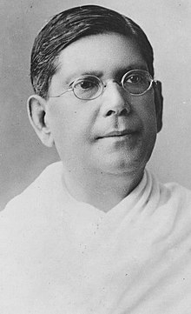
Hindu-Muslim Unity
The Pact was discarded in the Provincial Congress Conference
Bengal Pact, 1924
Agreement aimed to resolve Hindu-Muslim differences
To strengthen relations
Representation on population basis with separate electorates.
Local bodies’ representation; majority 60% and minority 40%.
Govt. appointments; 55% for Muslims. Till it is attained, Muslims 80% and Hindus 20%.
No resolution or enactment without consent of 75% of elected members of the affected community.
Music not allowed in front of the mosques.
No legislation in respect of cow slaughtering for food the Council.
Deshbondhu
Chittaranjan Das

Slide 13
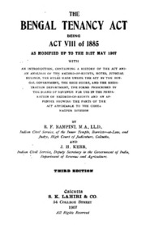
When the pact is put forward at the Kakinada session of congress gandhi and his allies have it struck down
In Bengal however the pact is upheld
June 1925: the unexpected and tragic passing of the Deshbandhu leaves a tremendous void
Subhas Chandra Bose is not released from arbitrary imprisonment by the Raj for two years under horrific conditions until 1927
Congress, already unpopular with Bengali Muslims for 1922 becomes even more suspect with the opposition to the Bengal Tenancy Act of 1928

Slide 14
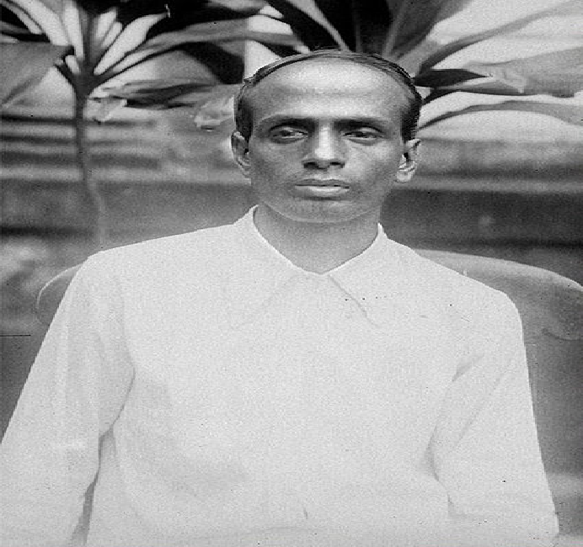
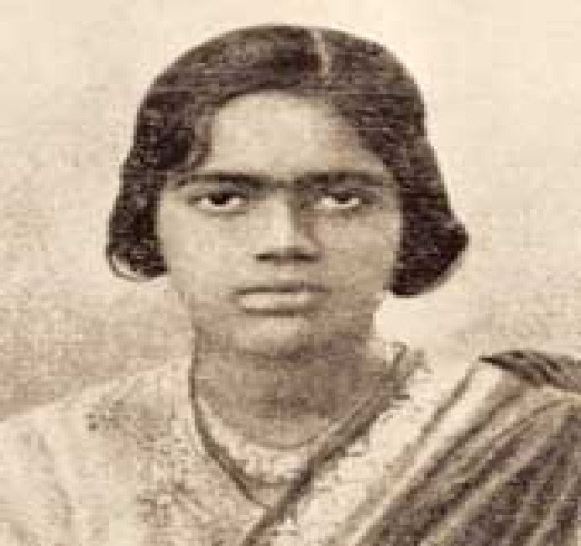


FREEDOM FIGHTERS OF THE CHITTAGONG UPRISING 1930

Slide 15
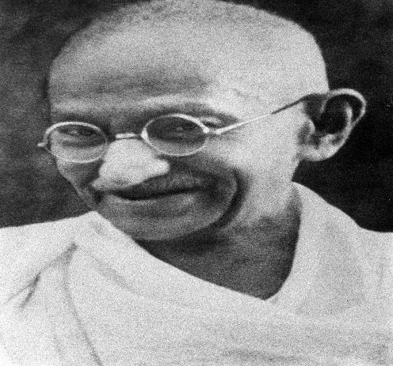
Mohan Das Karam Chand Gandhi
The legend of Mohandas Karamchand Gandhi, the ‘great-souled’ one or the mahatma to his followers and admirers
From the Gujarat region
Brief career in law
Awakened to injustice in British occupied Southern Africa
Fashions the tactic of ‘Satyagraha’ or ‘Struggle in Truth’ as a disobedience method
Returns to the subcontinent after the start of the First World War and is given the leadership position of Congress in 1920 after its failures to force concessions from the Raj

Slide 16
Gandhi leads three movements; Satyagraha-Khilafat (1921-1922), the Salt Tax Satyagraha (1930) and the Quit India Movement of 1942
Combines ‘self-suffering’ with strict non-violent civil disobedience
During 1946-1947 tries to mitigate Communal Riots
Assassinated by a Hindu extremist in 1948

Slide 17
Government of India Act 1935
Simon Commission report was boycotted
Features of the Act
Abolition of diarchy (2 ruling authorities ) at province, introduction at centre.
Indian Council replaced by an advisory body.
All India Federation with British India territories and princely states.
Safeguards and protective instruments for minorities.
Supremacy of British Parliament.
Increase in size of legislatures, extension of franchise, division of subjects into three lists and retention of communal electorate.
Separation of Burma from India
Communal award 1932; Congress and other parties had reservations
The Government of India Act, 1935 passed in the Parliament
Responsible govt. with adult franchise
General election was held in 1937 under this Act

Slide 18
Krishak-Praja Party(KPP) 1935
Nationalists failed to address welfare of poor peasants
Muslim League’s popularity declined
Demands of KPP
abolition of the zamindari system
peasants’ absolute proprietorship of land
reduction of land rent rate
giving interest free loans to peasants
creating irrigation facilities; digging canals
introduction of free primary education, etc.

Slide 19
KPP and the Bengal Legislative Assembly Elections of 1937
KPP election manifesto-‘Dal-Bhat’ for all
Opponents: Congress and Muslim League
Election result; KPP-36 (33 from Bengal), Congress- 52, and Muslim League- 39
KPP emerged as mass political party in Bengal
KPP formed coalition govt. with Muslim League

Slide 20
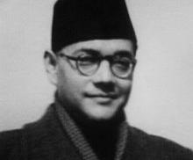
Subhas Chandra Bose (circa. 1930s)
A brilliant student of Philosophy at Cambridge University, Subhas Chandra Bose was the first Indian to resign voluntarily from the formidable Raj bureaucracy – the so-called ‘British Indian Civil Service’ – in 1921.
Imprisoned eleven times by the Raj for anti-colonial activities and as early as the 1930s was secretly acknowledged by London as the one “implacable foe of British rule” in the subcontinent.

Slide 21
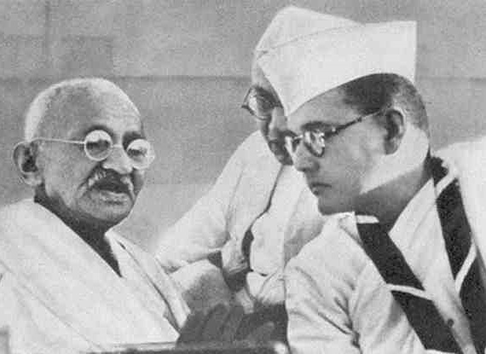
Karamchand Gandhi(left) with Subhas Chandra Bose(right) during a brief period of ‘truce’, Haripura Congress Session, 1938
Gandhi, who ascended to the supreme leadership of Congress after 1920 was bitterly opposed to the armed revolutionary tradition and saw in them his principal and hated rivals.
By the 1930s, Subhas Chandra Bose was the one mass leader in the subcontinent who envisioned an armed revolution to completely kick out the Raj.

Slide 22
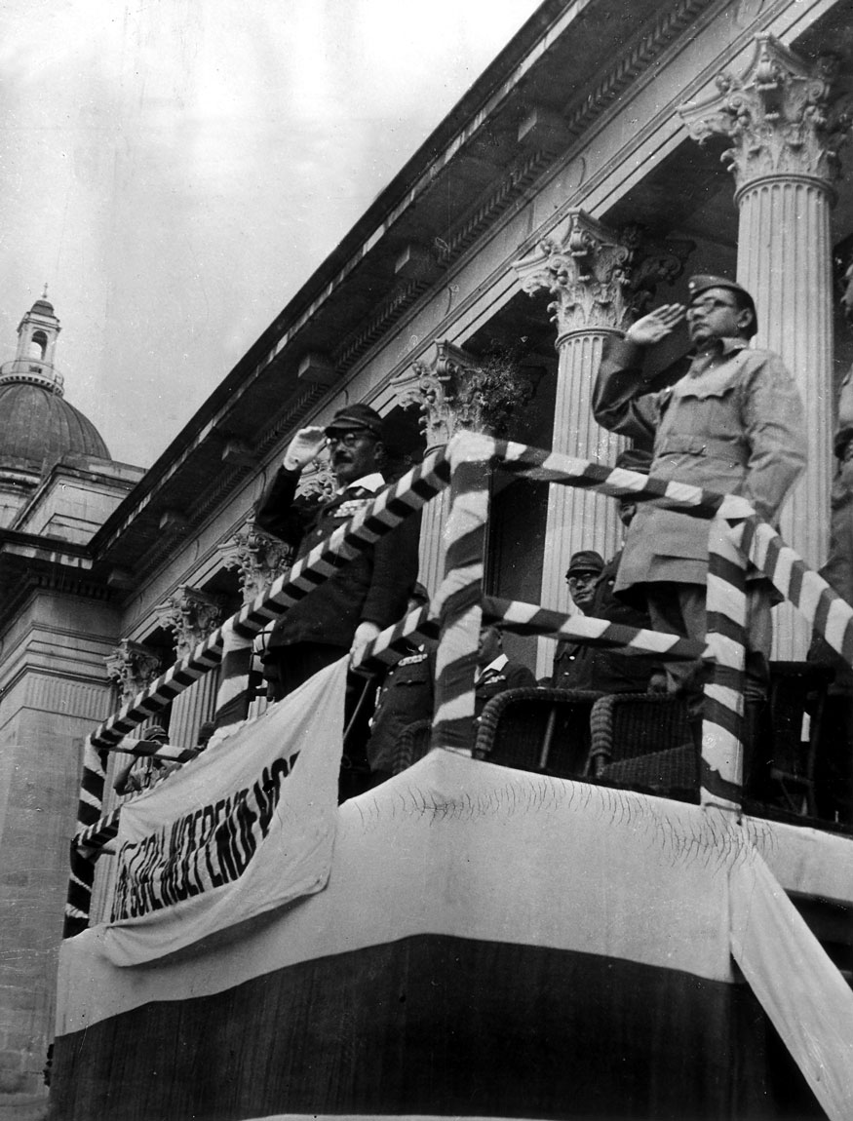
Netaji Subhas Chandra Bose & the Azad Hind Fauj
Azad Hind Fauj or Indian National Army (INA)
First formed in 17 February 1942; initiatives by Imperial Japanese Army
Subhas Chandra Bose arrived in Singapore in 1943 and revived the Army
Netaji allied with the Axis powers in WWII
INA gave hope for the freedom and self-governing rights in India
Subhas Chandra Bose with Japanese Prime Minister Hideki Tojo at a parade for Indian national independence at Singapore

Slide 23
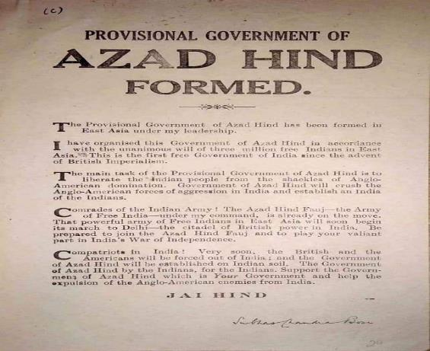
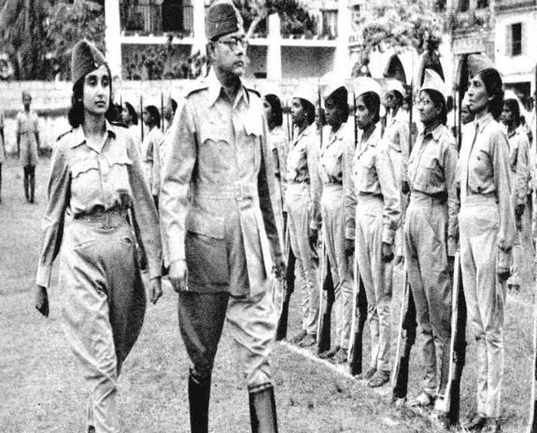
Netaji Subhas Chandra Bose & the Azad Hind Fauj
Netaji inspects the Rani of Jhansi regiment of the Azad Hind Fauj with Captain Lakshmi 1942

Slide 24
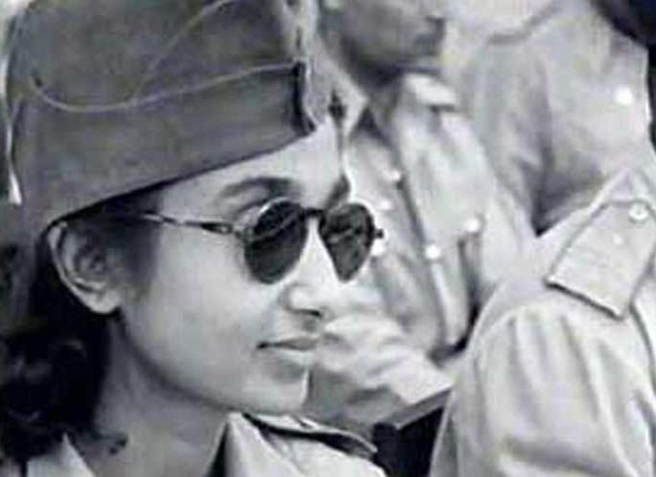
Lakshmi Swaminathan Commandant of the Rani Jhansi Regiment
A unique feature of the ‘Free India Army’ or ‘Azad Hind Fauj’ in East Asia was the formation of a fully-trained and armed women’s only regiment of freedom fighters.
Subhas Chandra Bose chose Lakshmi Swaminathan, a brilliant young doctor in Singapore, to organize and head the unit.
The regiment saw heavy combat during the retreat from Burma in 1944-45.

Slide 25
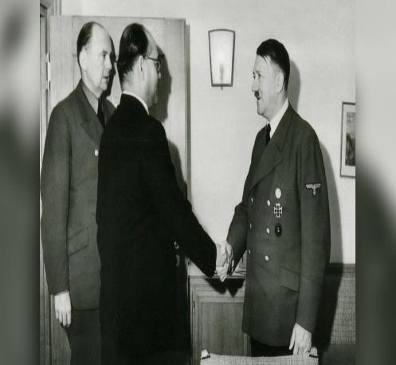
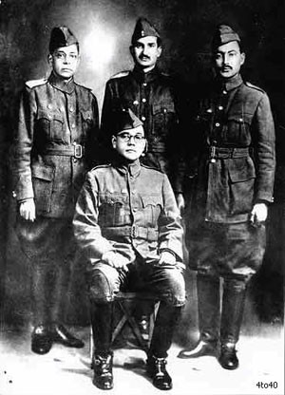
World War II and alliance with the Hitler
'Hindustan ki Ek Awaz: Sehgal, Dhillon, Shahnawaz

Slide 26
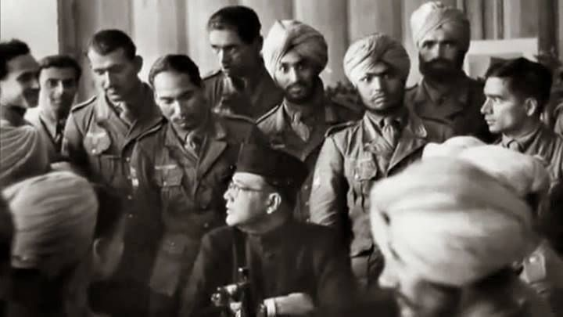

Slide 27
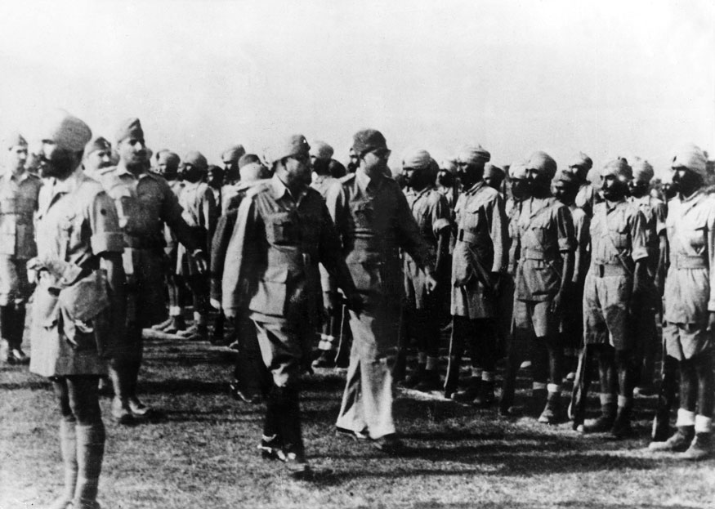
Netaji Subhas Chandra Bose & the Azad Hind Fauj
In 1943 Subhas Chandra Bose arrived in East Asia and established a provisional government of Free India and a larger army of liberation – the Indian National Army; composed of civilians from the subcontinent based in East Asia and mercenaries who had been captured by the Japanese
During 1943-1944 the Indian National Army took part in the Imphal-Kohima Campaign
On 18 August 1945; while traveling onwards to meet with Soviet officials, the plane carrying Subhas Chandra Bose crashed in Taipei
Subhas Chandra Bose dies later that evening from burn wounds – the only major subcontinental leader to die on the battlefield
Subhas Chandra Bose reviewing soldiers of the Indian National Army in 1944

Slide 28
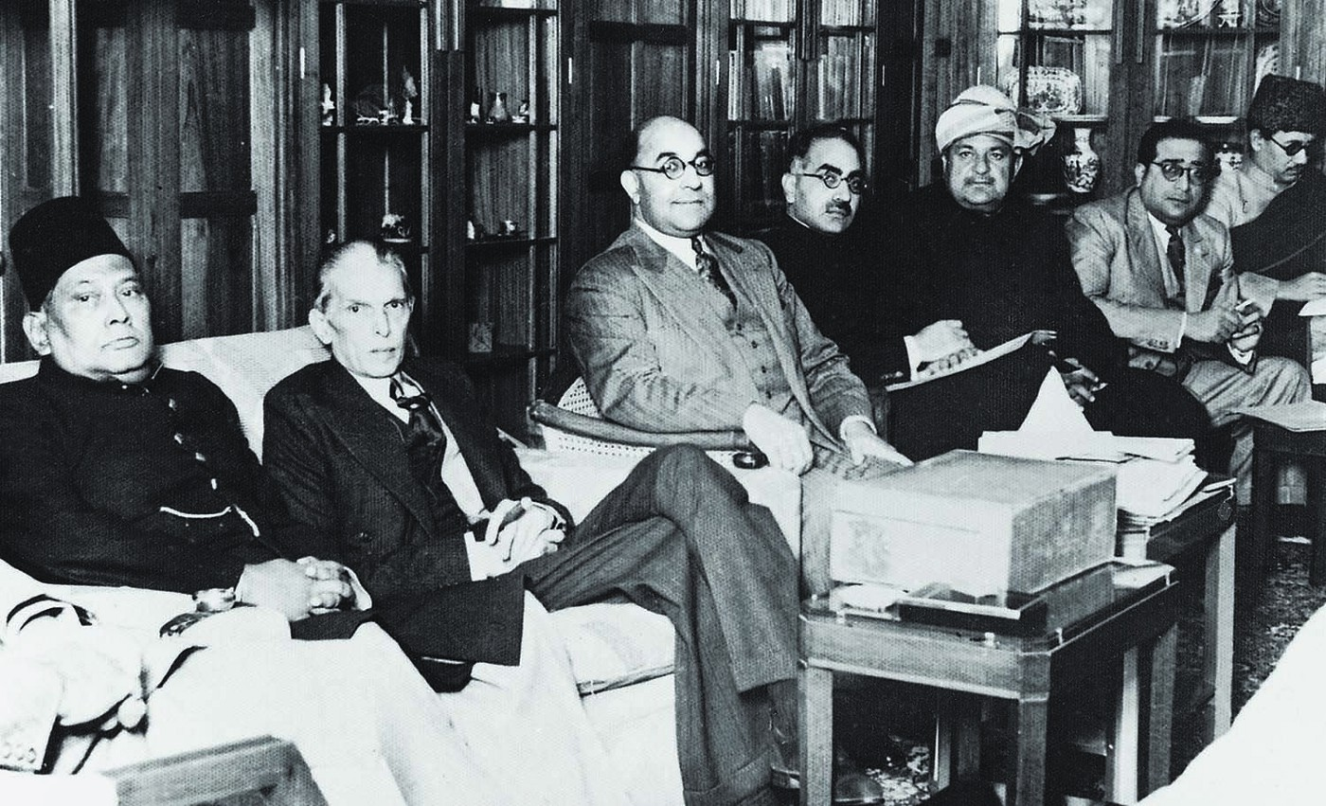
Lahore Resolution
All India Muslim League held a conference on 22-24 March 1940 in Lahore
Sir Sikandar Hayat Khan drafted Lahore Resolution that was presented by A. K. Fazlul Huq
Two Nation Theory: sovereign states for Muslims
From extreme left are Sher-e-Bengal A.K. Fazlul Huq and Mohammad Ali Jinnah. Muslim League Council Meeting in Bombay in the early 1940s. Photo: Dawn

Slide 29
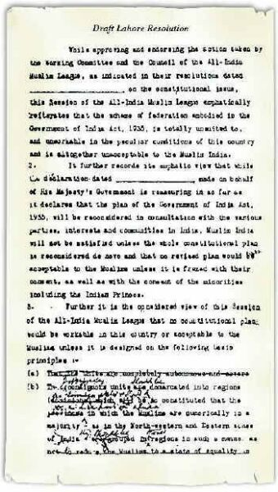
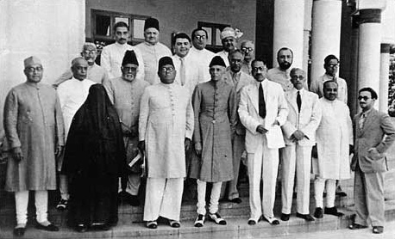
“…with such territorial readjustments as may be necessary that the areas in which the Muslims are numerically in a majority as in the North Western and Eastern Zones of (British) India should be grouped to constitute ‘independent states’ in which the constituent units should be autonomous and sovereign.”
Lahore Resolution
A line from Lahore Resolution
Draft Lahore Resolution- with proposed changes by Jinnah and Barkat Ali
Working committee of the Lahore session of All India Muslim League
Bangladesh Studies
29

Slide 30
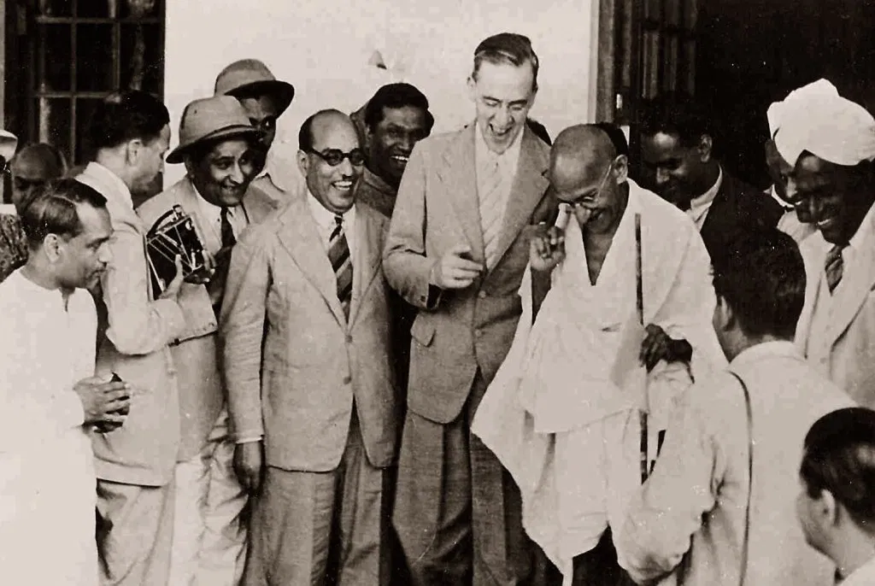
Cripps Mission & Quit India Movement
In April 1942 Sir Stafford Cripps was sent to Delhi
Offered independence of India; a constituent assembly and more seats in Viceroy’s executive council
Emphasized not to pressurize any part of the country to join independent India
Congress and British PM Churchill opposed the mission’s proposal
Failed mission led to ‘Quit India’ movement in August 1942
Sir Stafford Cripps enjoys a joke with Mr. Gandhi on his diplomatic mission in India, surrounded by Indian journalists and photographers

Slide 31
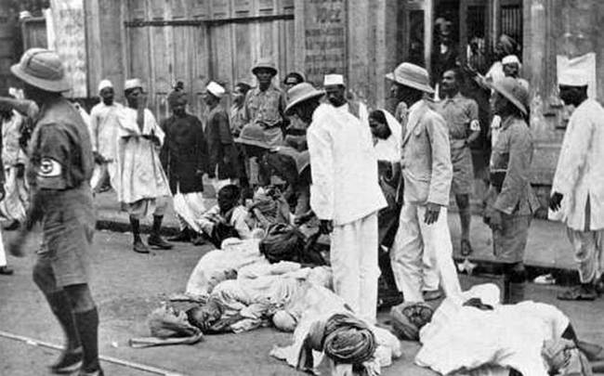
Quit India Movement
Police lathi-charge demonstrators during the Quit India movement (1944-42)

Slide 32
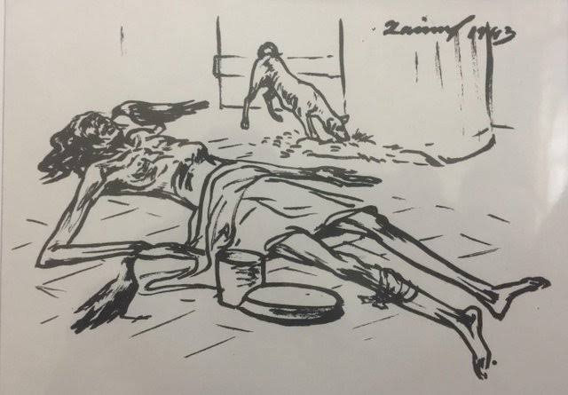
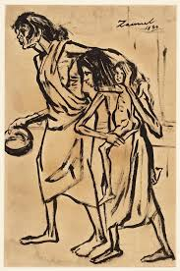
Bengal Famine of 1943
Causes of famine
Man-made famine
Natural disaster aggravated by administrative failure when rice export to Bengal from Japanese occupied Burma dried up
Rice taken for British army
Boats were confiscated by the British and inland waterways trade stopped
Market prices, widespread corruption and shortages
Sketches of the Famine of 1943 by Zainul Abedin
Bangladesh Studies
32

Slide 33
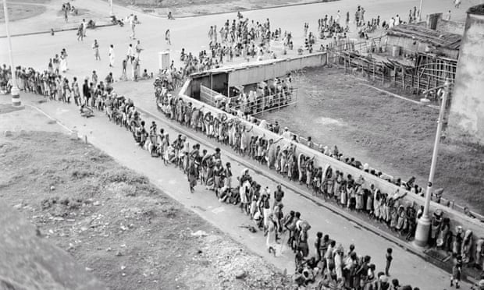
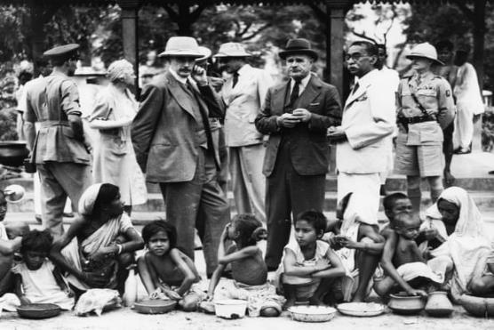
Bengal Famine of 1943
Winston Churchill in 1940 Britain’s wartime leader has been quoted as blaming the famine on the fact Indians were ‘breeding like rabbits’

Slide 34
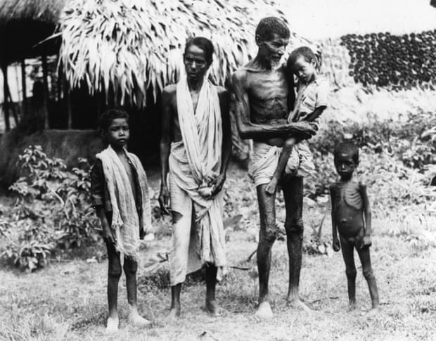
A family of 5
Somewhere in Bengal

Slide 35
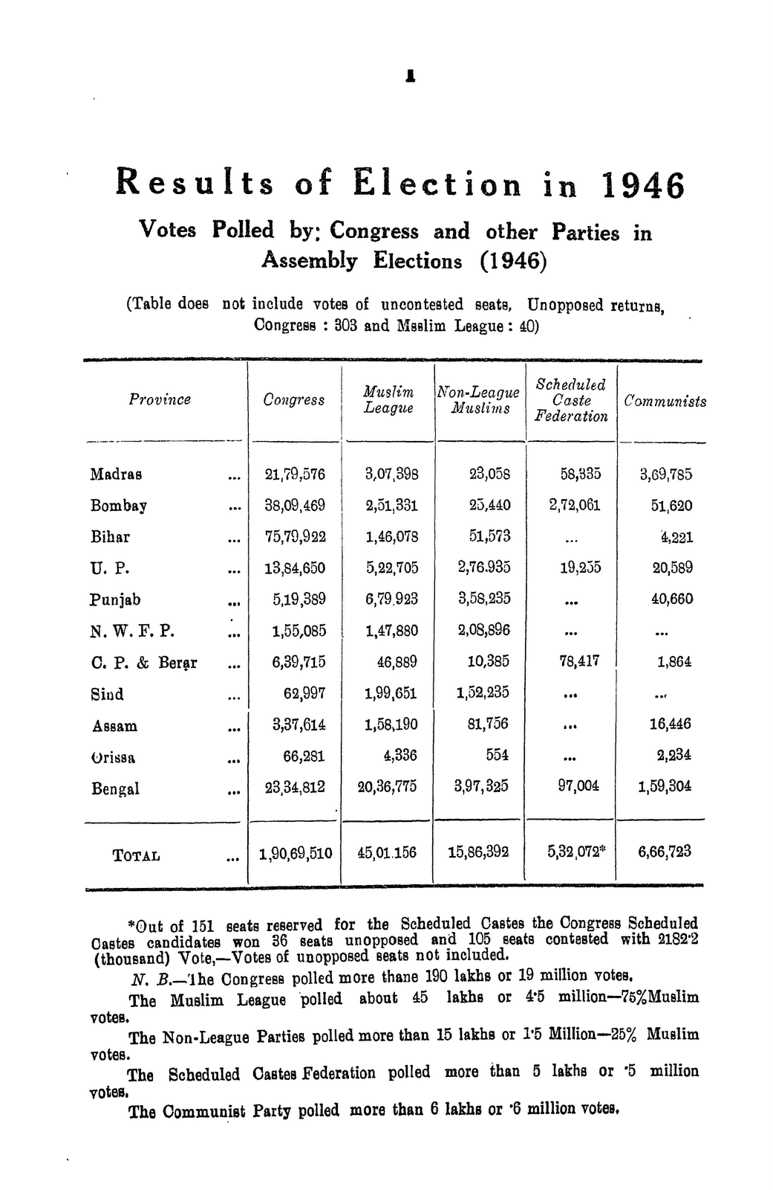
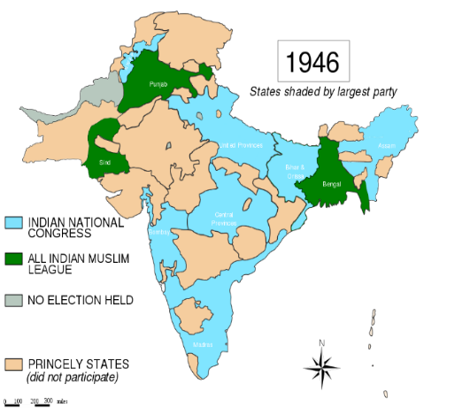
Elections of 1945-46

Slide 36
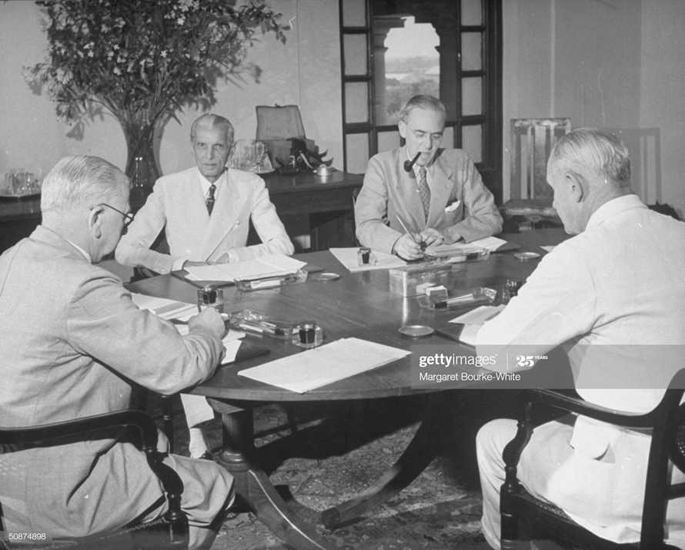
Cabinet Mission, 1946
Three-man cabinet deputation to New Delhi
Transfer of British power to a single Indian administration
Proposed a three-tier federation for India
Local provincial governments can opt out
Primarily both ML and Congress agreed
Nehru- no Constituent Assembly could be “bound” by any prearranged constitutional formula
Muslim League withdrew its support
British Cabinet commission members A. V. Alexander (L) Frederick William Pethick-Lawrence (R) & Sir Stafford Cripps (2R) discussing plan for India's Independence w. Moslem League ldr. Mohammed Ali Jinnah (2L) during meetings at the vice-regal lodge

Slide 37
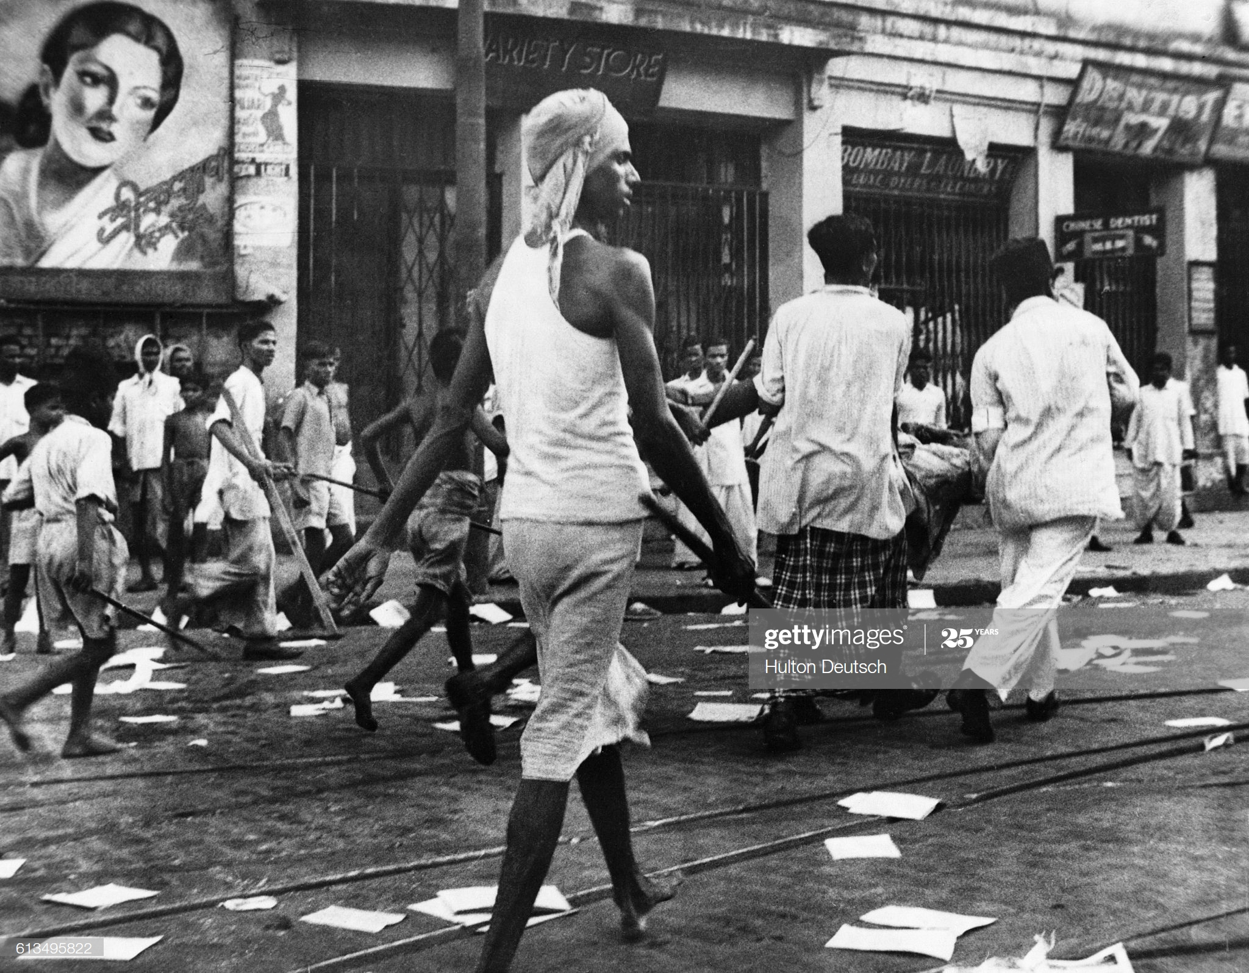
Direct Action Day and the Great Calcutta Killings
Muslim League announced a general strike on 16 August 1946
Widespread communal rioting between Muslims and Hindus
An estimated 4,000 people lost their lives
These events sowed the seeds for the eventual Partition
Rioters armed with lathis on the streets
of Calcutta in 1946

Slide 38
Proposal of United Bengal
Huseyn Shaheed Suhrawardy, the Premier of the province of Bengal, formally launched this idea
Sarat Chandra Bose proposed for a Sovereign Socialist Republic of Bengal
Most provincial Congress and Hindu Mahasabha leaders wanted Bengal partition
The Direct Action Day aggravated communal tension

Slide 39
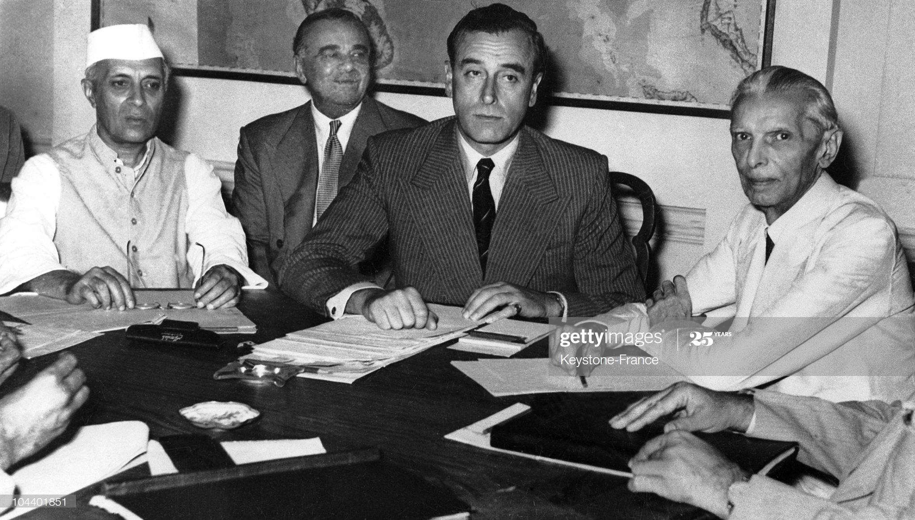
Partition Plan & the Radcliffe Boundary Commission
Boundary Commission created in July 1947
The commission was appointed by the British Government
Chaired by Sir Cyril Radcliffe
To recommend how the divide Bengal and Punjab between India and Pakistan
Sparked mass migrations
When there was a country I searched for freedom. Now I am free, but have to search for a country
During an historic conference in New Delhi, Lord Mountbatten and the main Indian leaders agree upon the partition of India according to a British plan. At the conference, from left to right: Pandit Jawaharlal Nehru, Lord Ismay, councilor to Lord Mountbatten and India's viceroy; and M. A. Jinnah.

Slide 40
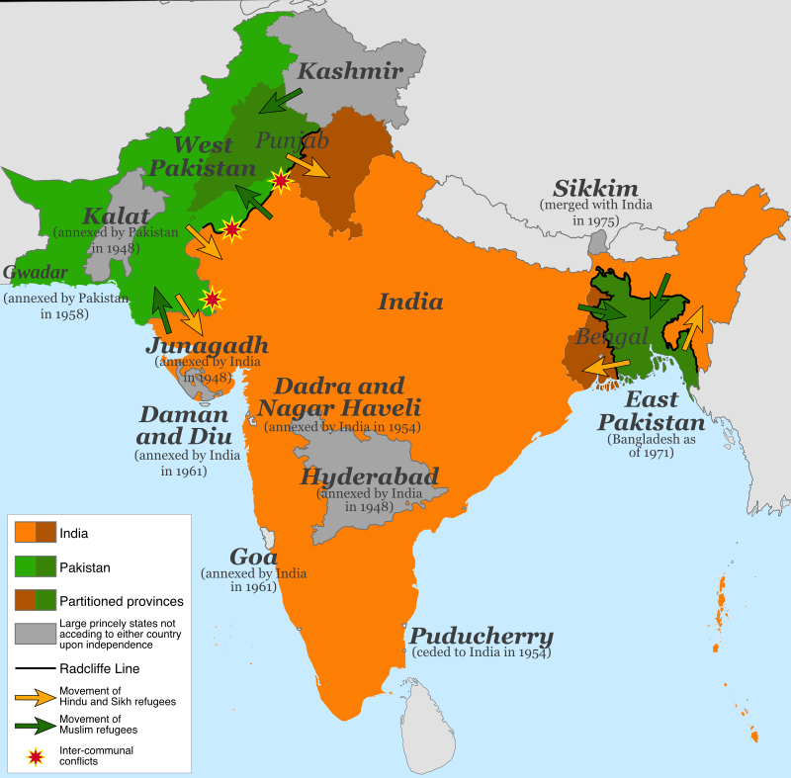
Partition Plan & of Radcliffe Line

Slide 41
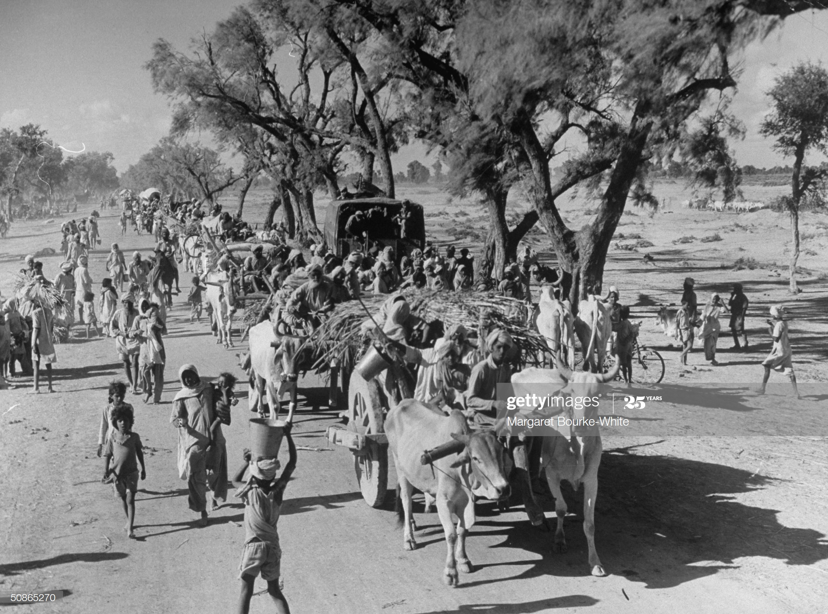
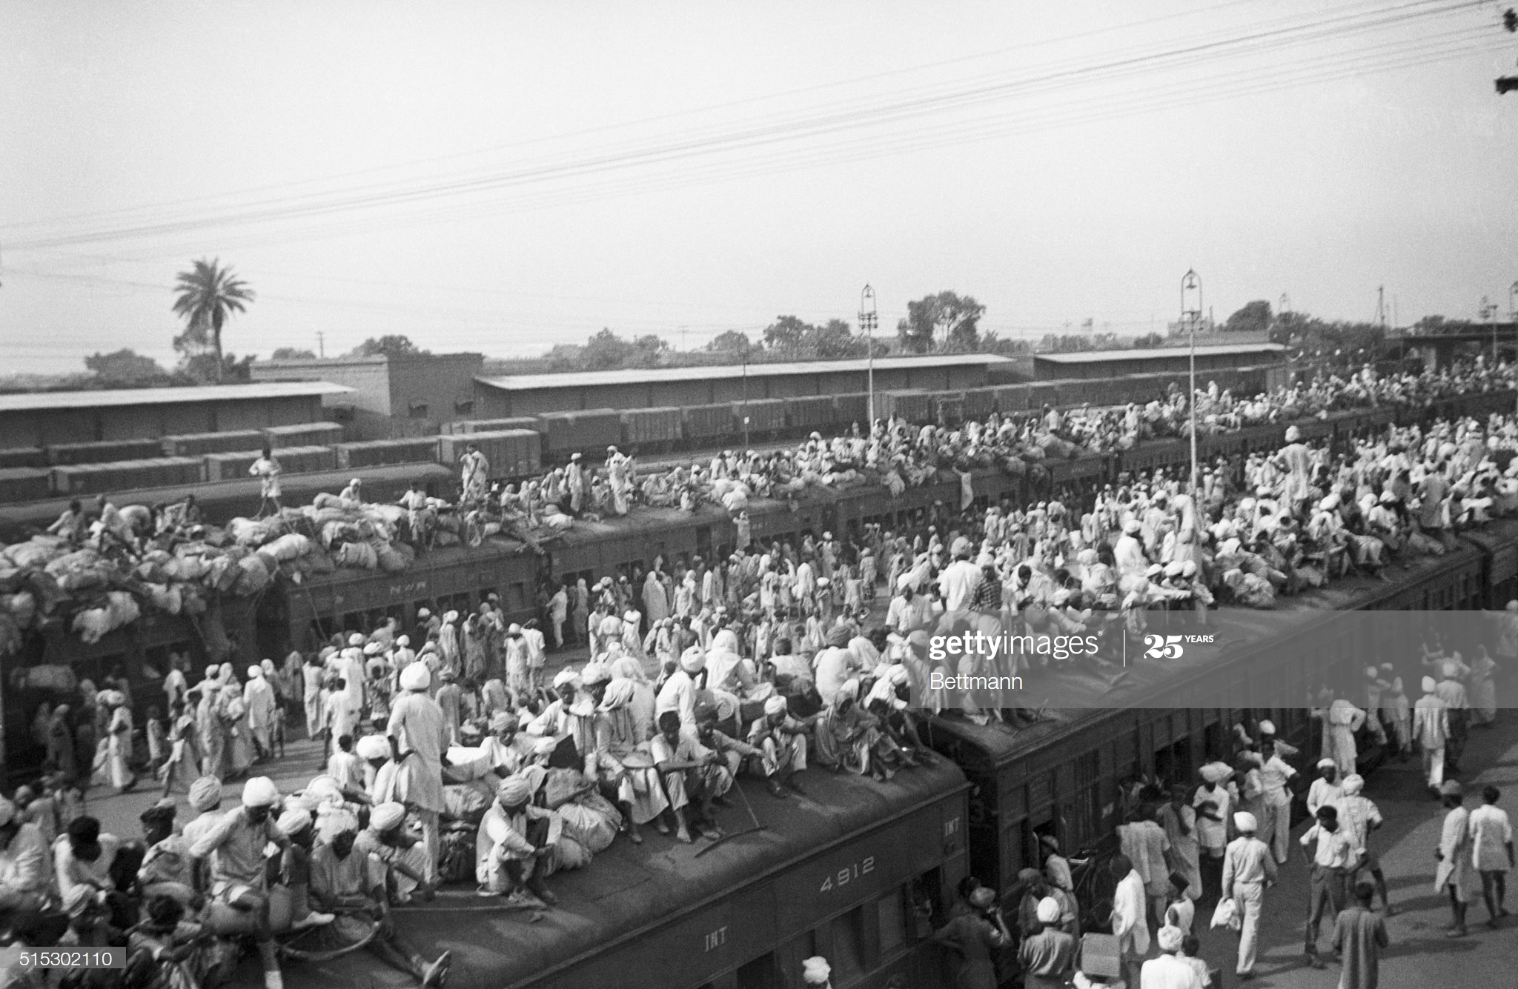
Refugee Crisis
Indian refugees crowd onto to trains as a result of the creation of two independent states, India and Pakistan. Muslims fled to Pakistan and Hindus fled to India in one of the largest transfers of population in history.
Convoy of Sikhs migrating to East Punjab after the division of India

Slide 42
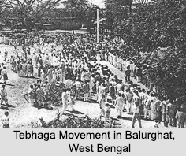
Tebhaga Movement
The movement aimed to establish the right of share croppers or borga-chashis to two-thirds of the crops

Slide 43
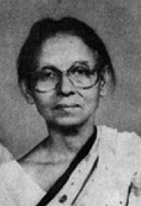
Tebhaga Movement
Popularly called RaniMa, Ila Mitra was one of the leaders of the Tebhaga movement. She led the Nachol rebellion of peasants and Santhals which was crushed by the Pakistan army and police in 1950. She was arrested, brutally tortured by the Pakistan government and imprisoned. Finally in 1954 she was freed by the Jukto Front government.
https://www.youtube.com/watch?v=OgtpUqrIUz4&ab_channel=BuddhadebBhattacharyaArchives%28Unofficial%29

Slide 44
References
Bose, Sugata & Jalal, Ayesha, Modern South Asia: History, Culture, Political Economy (New York and London: Routledge, 2004).
Bandyopadhyay, Sekhar, From Plassey to Partition: A History of Modern India (New Delhi: Orient Longman, 2004)
Hasan, Tariq, Colonialism and the Call to Jihad in British India (New Delhi: Sage, 2015)
Metcalf, Barbara D. &amp; Metcalf, Thomas R., A Concise History of Modern India (Cambridge:Cambridge University Press, 2006).
Sarkar, Sumit, Modern India: 1885-1947 (New Delhi: Pearson, 2014) and Chapter 7, pp. 321- 353 & Chapter 8, pp. 355-389.
Schendel, Willem Van, A History of Bangladesh (Cambridge: Cambridge University Press, 2009), (Chapters 09 & 10).
Butalia, Urvashi, The Other Side of Silence: Voices from the Partition of India (New Delhi: Penguin Books, 1998).

